Slide 1
Explorer Hat Activity 2
DC Motor with GUI Control

Slide 2
The Scenario
This activity enables the programmer to use the DC motor they connected in the previous activity, and control it with a simple graphical user interface (GUI).

Slide 3
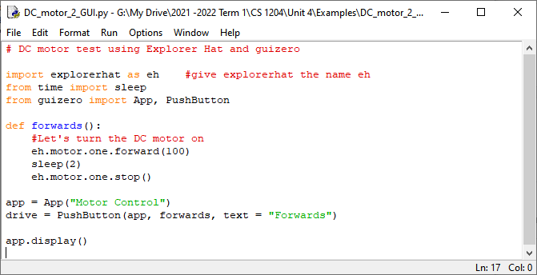
The Code

Slide 4
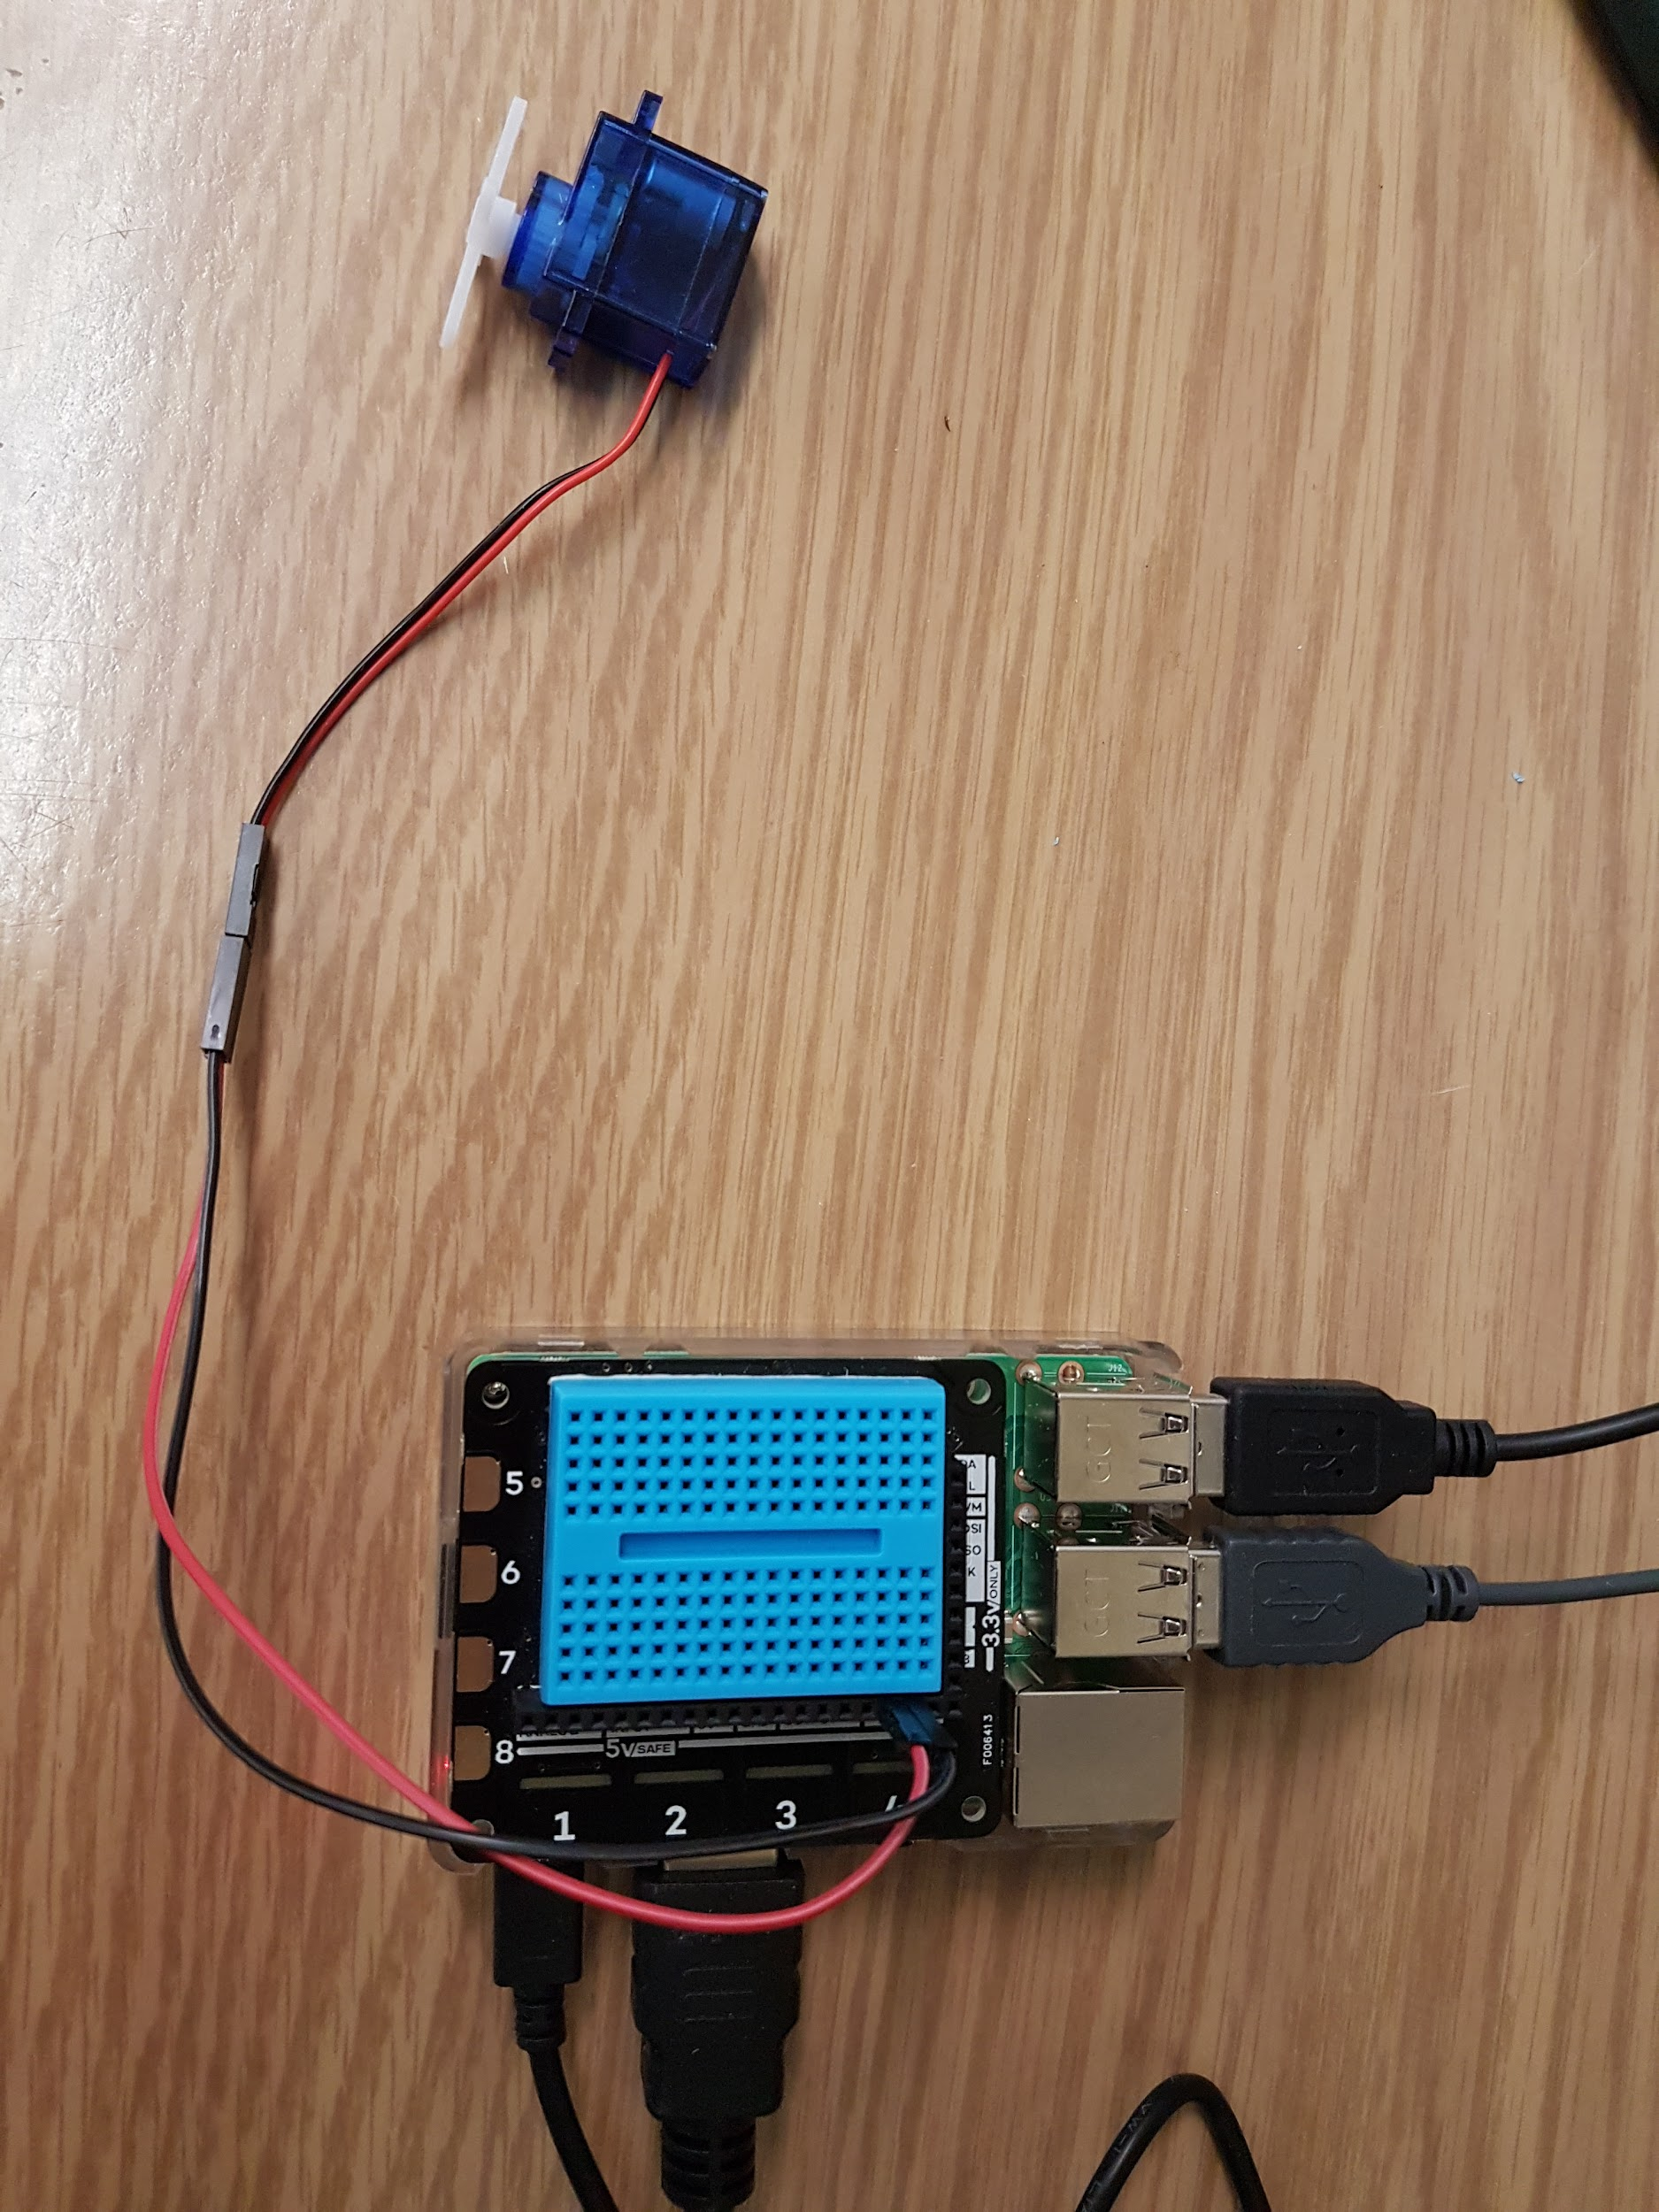
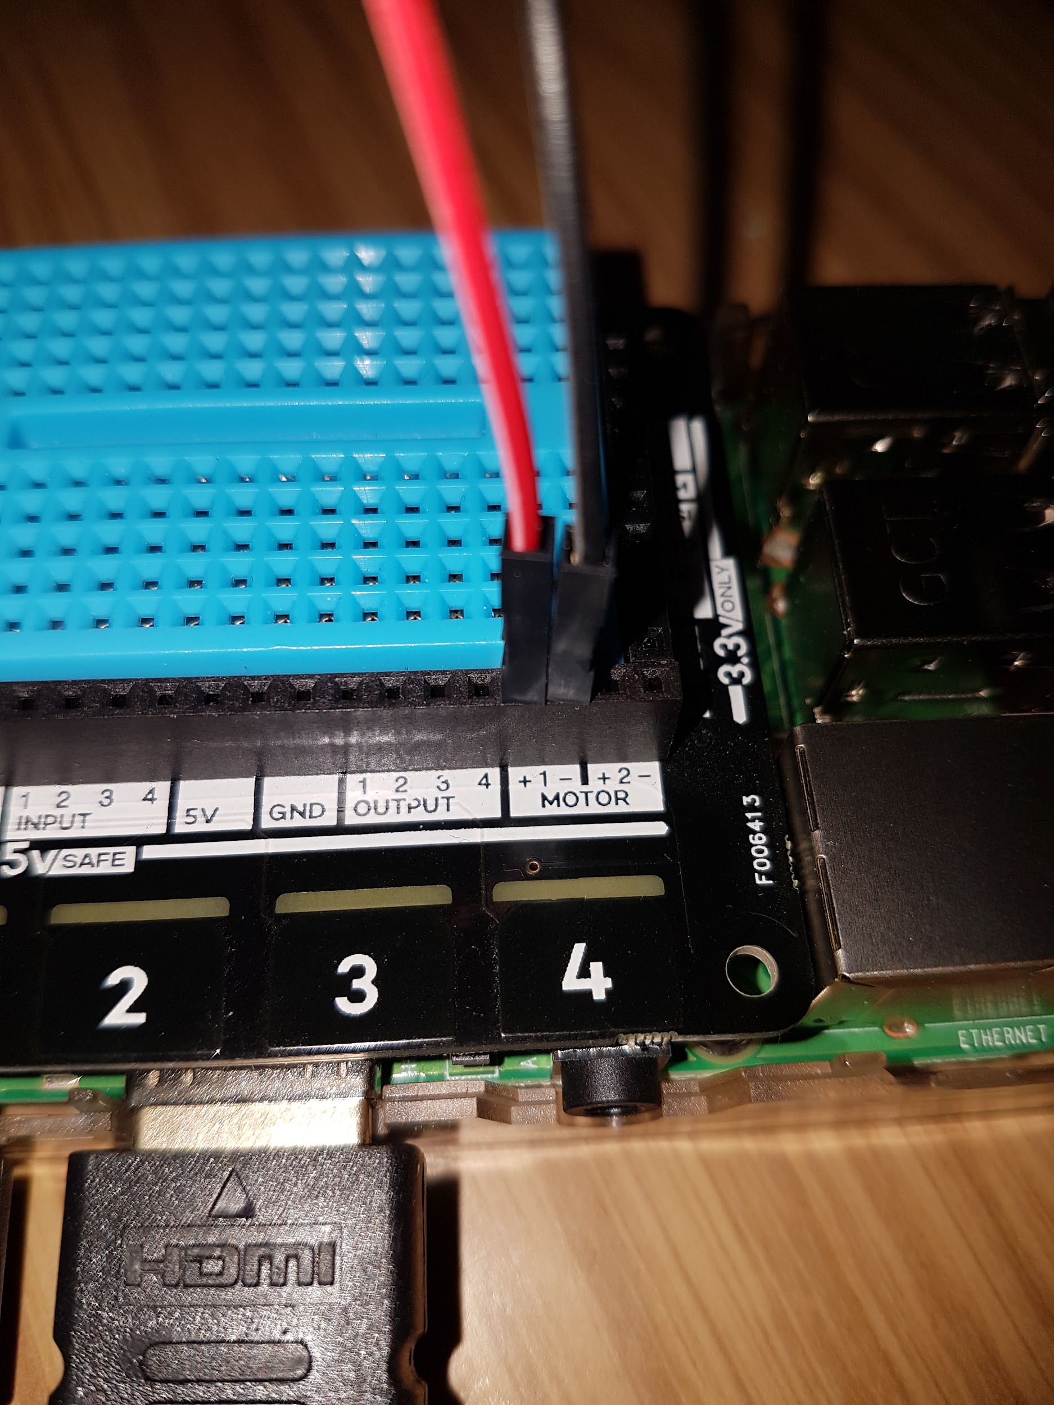
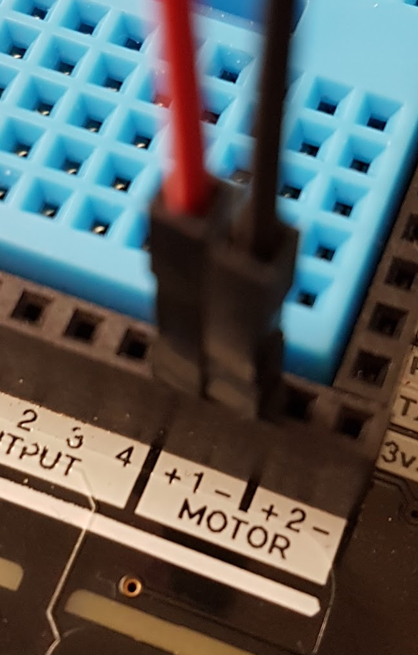
The Setup (it’s the same as the previous one)

Slide 5
Try This
Modify the code to add a button to make the motor spin in the opposite direction.
You may need to look at the website for the explorer hat(in the important links doc)

Slide 6
In Action
Click the link below to view a video of this circuit in operation.
DC Motor Controlled through a GUI

